Slide 1
About this Course
Understand about the OpenShift and Web Console Perspectives.
Understand about the QuickStart Overview with respect to CP4S.
Understand about the Cli tools and Overview.
Understand about the OpenShift Installation.
Understand about the OpenShift Build and Deploy an application.
Understand about the Role, Authentication and Authorization.
Understand about the Encryption, Backup and Restoration Process

Slide 2
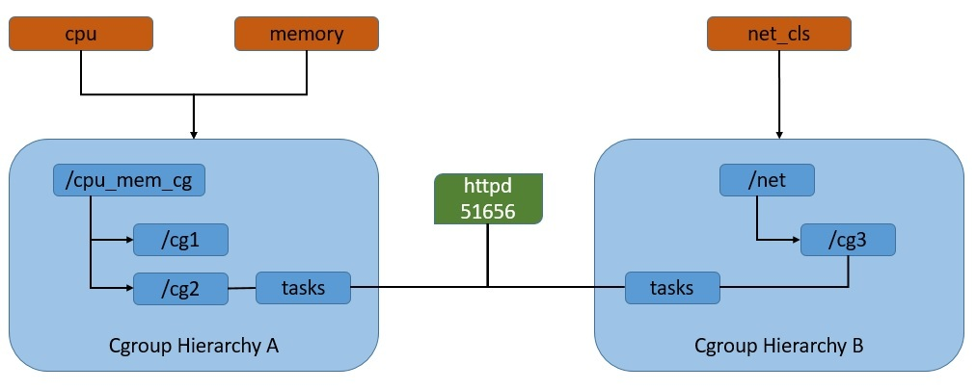
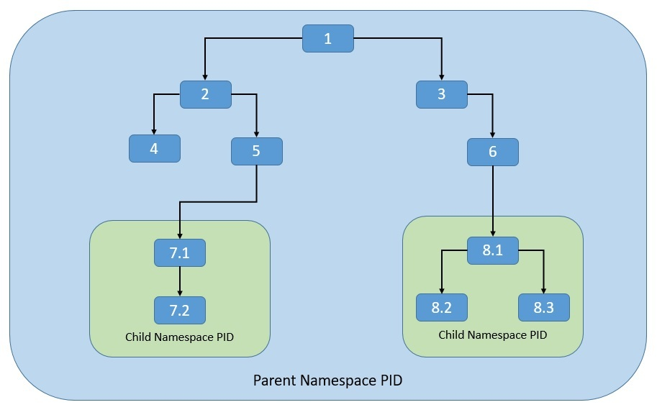
CGroups
Namespace
The cgroups feature was started by Google under the name process containers way back in 2007 and was merged into the Linux kernel mainline soon after. Basically, cgroups provide a unified interface for process isolation in the Linux kernel.
it allows us to partition kernel resources such that one set of processes is able to see resources that aren’t visible to other processes. These resources include process trees, hostnames, user mounts, and file names, among others.

Slide 3
VM Management
Kubernetes
app1
app2
app3
app4
app1
app2
app3
app4
APP1
APP2
APP3
APP4
Bins/libs
Bins/libs
Bins/libs
Operating Systems (OS)
Guest OS
APP5
APP6
APP7
APP8
Bins/libs
Hypervisor
APP9
APP10
APP11
APP12
Host Operating System
Host Operating System
Infrastructure
Infrastructure
Infrastructure
Traditional
Virtual Machines
Container Technologies

Slide 4
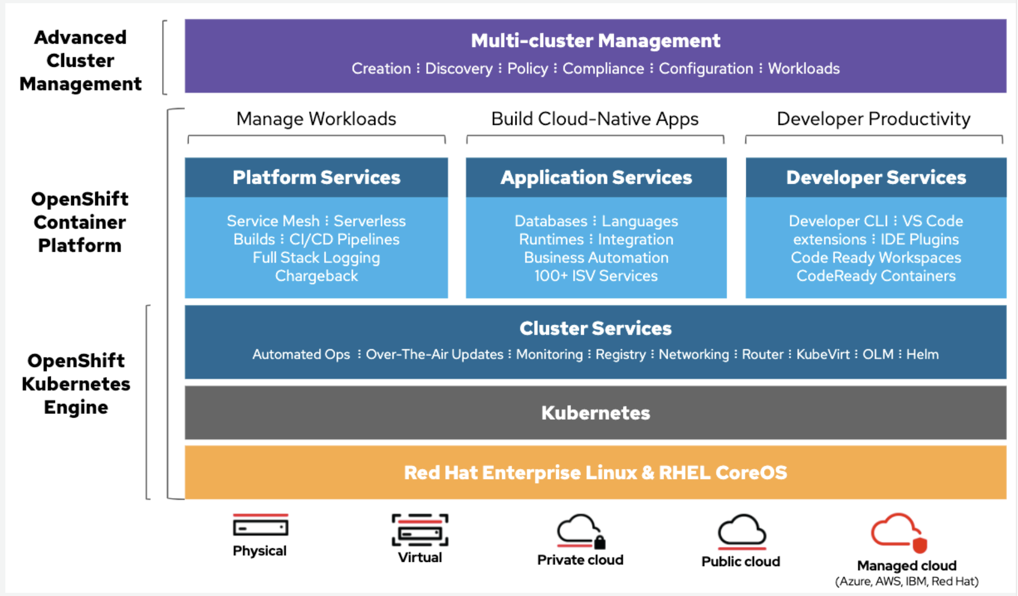

Slide 5
Overview of CLI Tools
openshift-install
oc
kubectl
Terraform
AWS Cli
Podman
Docker
Taskcat

Slide 6
OpenShift Installation Process
IPI Method
UPI Method
Air Gapped Install
Importance of IaaC Here
OpenShift Installation is an immutable Infrastructure and a big installation; Hence it is recommended to implement in deployments of Applications.
Terraform plays a crucial role in spinning up of OpenShift Cluster and managing this immutable Infrastructure.
Ansible is recommended to setup the project and user level governance model like cluster Quota and limits and requests.

Slide 7
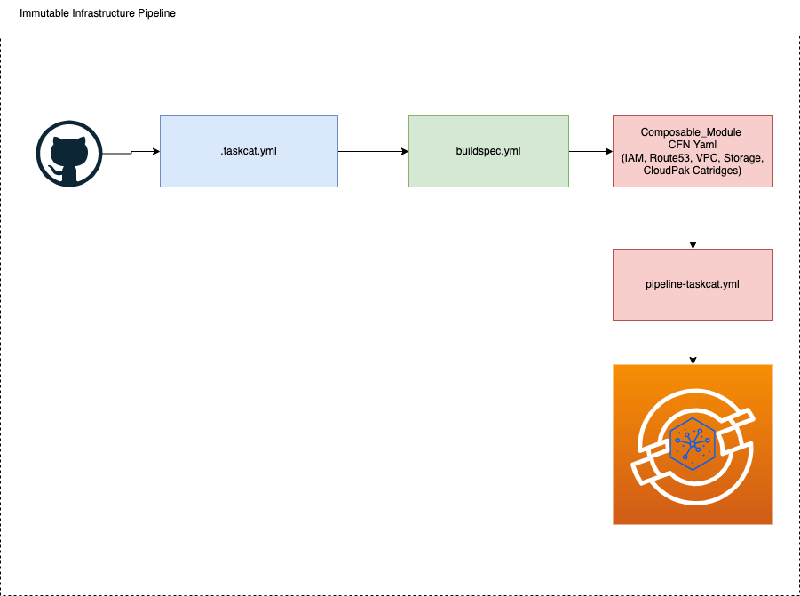
Container Quick Starts
These form the UPI method of Installation through Automated templates (Cloud Formation Templates)
Cloud Formation Templates & Terraform plays a crucial role in spinning up of OpenShift Cluster and managing this immutable Infrastructure.
It can be installed from AWS Market Place as well through BYOL Concept.
Also, automated deployment can be handled through Taskcat tool.

Slide 8









OpenShift Reference Architecture
AWS Cloud
Availability Zone 1
Availability Zone 2
Availability Zone 3
Public subnet
Public subnet
VPC
Public subnet
NAT gateway
OpenShift Auto Scaling group
NAT gateway
Private subnet
Private subnet
Private subnet
Master Node
Master Node
Master Node
Compute Node with Storage
OpenShift Auto Scaling group
Compute Node with Storage
Compute Node with Storage

Slide 9
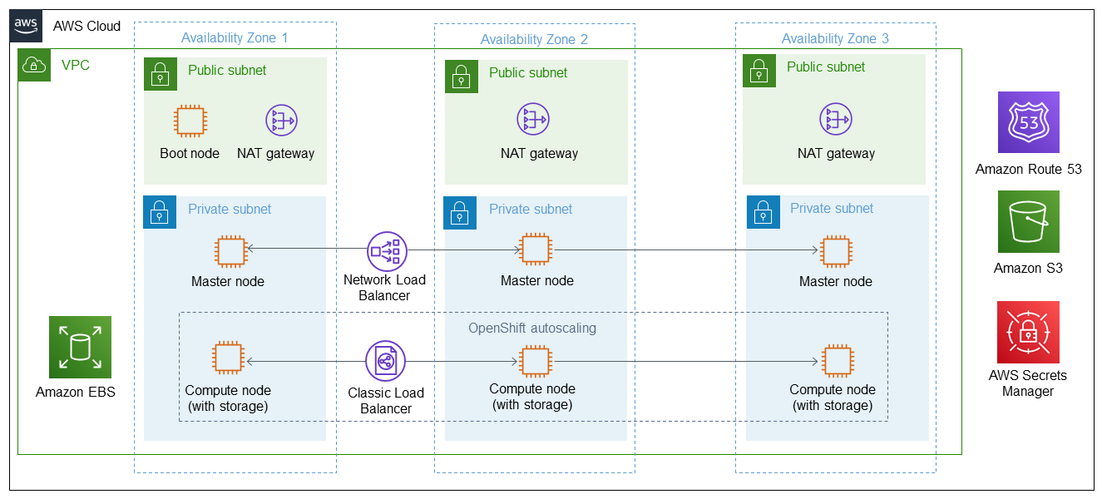
CP4S Reference Architecture

Slide 10
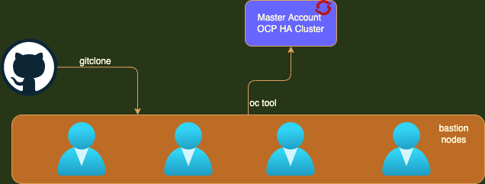
Access OpenShift Cluster

Slide 11
Technology | Rationale
Terraform | Immutable Infrastructure, Declarative Style, Orchestration tool, only partial support for packaging and templating. Life Cycle and State management. Excellent support for VM Provisioning, Network and storage management.
Ansible | Configuration Management, provides support for mutable infrastructure, Procedural Language, Partial support for VM Provisioning.
Jenkins | Build and deployment Orchestration, Award winning opensource projects.
Travis CI | Excellent CI Tool, Not a free version available. But excellent tool for GitHub monitoring & Webhook Setup.
GitHub | Version Control, Industry Leader
SonarQube | Code Quality Gateway, Industry Proven
GitOps | For Better CD Orchestration Workflow
Hashicorp Vault | For Storing Credentials and secrets managements.
ArgoCD | Declarative DevOps
Groovy | Pipeline Orchestrator
OC | OpenShift Command Line Utility
Helm Charts | Package Manager for Kubernetes
Kubectl | Kubernetes Command Line Utility
Kustomize | Kubernetes native configuration Management
Podman | Container Orchestration
AWS Cli | AWS Command Line Utility
AWS Cloud Formation | AWS Cloud Formation for Better Resource management and Provisioning of resources.

Slide 12
Q & A

